Slide 1

What you learn from this course
How to setup a required infra for azure project development.
Creating ADF pipelines, triggers.
Data cleaning, modelling, transformations, etc.
Creating feature, dev/collaboration, main branches in azure for version control.
How to create a pull request (PR) and get an approval for the same after code review.
Create/Update sprints for tracking the development progress in ADO board against user stories assigned.
Creating PySpark and Spark SQL Code in Databricks notebooks and executing it through via ADF Pipeline.
Incremental (or) Delta load, Full load implementation by using ADF.
How to create metadata driven ETL Pipelines in ADF by using the metadata tables.
Logging, email alerting, checking the error logs etc.
Data governance by using Role Based Access Control (RBAC) and Unity Catalog (UC).
How a project will be deployed in Production environment.
Executing a project in agile methodology.
Telecom domain functional knowledge.

Slide 2
Who can enroll for this project
Students who are pursuing their final year
Non cloud data engineers who want to move to azure cloud
Other discipline IT employees who want to migrate their career to a cloud data engineer
Who wants to gain real time project execution experience as a azure data engineer
Who wants to show their real time project experience in their resumes
Prerequisites to execute this project
Azure account with valid subscription (Free trial/Pay as you go)
Azure fundamentals (ADF,ADLS,ADB)
Python, SQL, Spark Basics
Dedication and patience

Slide 3
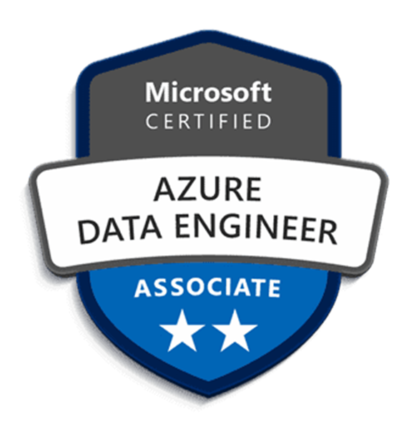

Instructors
Role | Experience | Certifications
Senior Data Engineer | 9 Years
Azure Administrator | 3 Years
Azure Cloud Engineer | 3 Years

Slide 4
FAQ’s
Q: Generally how many years of experienced cloud data engineers can execute this kind of project in real time?
A: Around 3 years. So, if you are able to execute this project by your own then you may be considered the same level of experienced data engineer
Q: Shall we explain this project in our future interviews for cloud data engineer role?
A: Yes. You can explain by adding some client name and with the similar project use case.
Q: Live class timings?
A; 5 weekends (Saturday & Sunday). 9 AM IST to 11 AM. Starts on 6th January, 2024.
Q: Where we can learn basics for ADF, Databricks?
A: Clever Studies Job Ready Program Road Map - Google Sheets
Q: If we have any queries while executing this project ? Where to post our doubts.
A; You can join our WhatsApp or Telegram group and post your queries. Or send an email as well (Links given in next slide) .
Q: What is the course fee and where to enroll.
A; Please visit our website Clever Studies for more details.

Slide 5
Social Media Appearance
WhatsApp Group joining link : https://chat.whatsapp.com/C70cGzAEKC1LnSw60U9FVO
Telegram Group joining link: https://t.me/+eMaiZNWTPmZkYmVl
Email: cleverstudies.edu@gmail.com
Clever Studies LinkedIn: Naresh Kumar Boddupally | LinkedIn
Facebook: https://www.facebook.com/profile.php?id=61554388460897
Instagram: Clever Studies (@cleverstudiesindia) • Instagram photos and videos

